Slide 1
Modules and Functions

Slide 2
Review
Logic constructs = Statements can be used in a program.
3 basic constructs: Sequence, selection constructs (if, if…else, ?:), Iteration constructs (for/ while/ do … while)
Walkthrough
Code are executed by ourself
Tasks in a walkthrough: a record of the changes that occur in the values of program variables and listing of the output, if any, produced by the program.
Debug program

Slide 3
Objective to learn Modules and Functions
After studying this section, you should be able to:
Code Organization: Programs are structured, making them easier to read and maintain.
Reusability: Functions allow reuse of code, reducing duplication.
Debugging and Testing: Isolated functions simplify locating and fixing bugs.
Maintainability: Modular code supports easy updates and changes.
Abstraction: Functions hide implementation details, focusing on functionality.
Scalability: Modular design enables handling larger and more complex systems.
Collaboration: Teams can work on separate modules independently.

Slide 4
Objective
Define a C-module or C-function?
Explain module’s characteristics
Implement C functions
Use functions?
Differentiate built-in and user-defined functions
Explain mechanism when a function is called
Analyze a problem into functions
Implement a program using functions
Understand extent and scope of a variable

Slide 5
Contents
What is a module?
Characteristics of modules
Hints for module identifying
C-Functions and Modules
How to implement a function?
How to use a function?
What happen when a function is called?
How to analyze a problem into functions?
Implement a program using functions
Extent and Scope of a variable
Walkthroughs with Functions

Slide 6
1- What is a Module?

Slide 7
What is a Module?
Module is a portion of a program that carries out a specific small function and may be used alone or combined with other modules to create a program.
Natural thinking: A large task is divided into some smaller tasks.
Example: To cook rice we divide it into small tasks
(1) Clean the pot; (2) Measure rice; (3) Washing rice; (4) add water;
(5) Boil; (6) Keep hot 10 minutes.

Slide 8
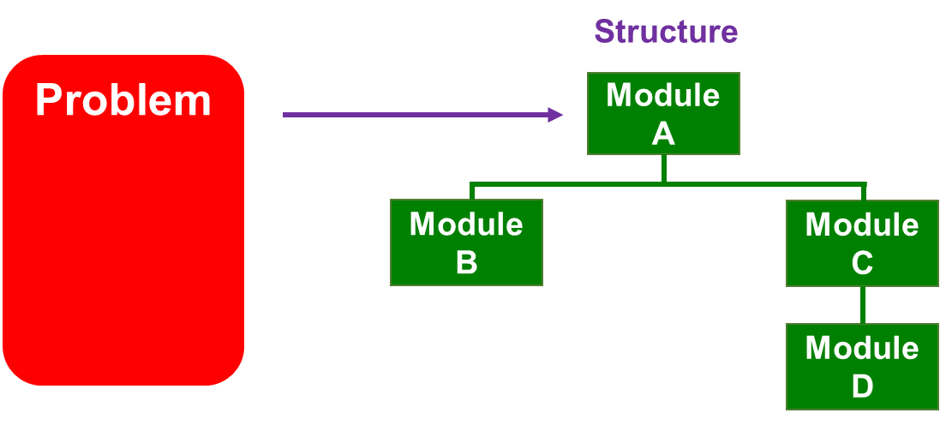
Modules: Structure Design
In designing a program, we subdivide the problem conceptually into a set of design units. We call these design units as modules. In subdividing the problem, we reduce the number of factors with which to deal simultaneously.
Some related modules can be put into a file
(You used it – stdio.h)

Slide 9
Structure design - Example
Problem: Develop a program that will accept a positive integer then sum of it’s divisors is printed out.
Solution:
Analyze | Code | Description
 | #include <stdio.h> #include <stdlib.h> | Use modules in this file
Divide the program into small tasks: | int main { int n; int s; | Declare the main module and it’s data
Task 1 - Accept n | scanf(“%d”, &n); | Use a module scanf in the stdio.h
Task 2 - s = sum of it’s divisors | s = sumDivisors (n); | Module will be implemented
Task 3 - Print out s | printf(“%d”, s); | Use a module printf in the stdio.h
Task 4 - Pause the program | system(“pause”); | Use a module system in the stdlib.h
 | }

Slide 10
2 - Characteristics of Modules

Slide 11
Characteristics of Modules
Characteristics | Reason
It is easy to upgrade and maintain | It contains a small group of code lines for a SPECIFIC task.
It can be re-used in the same program | It has a identified name ( a descriptive identifier) and can be used more than one time in a program.
It can be re-used in some programs | if it is stored in an outside file (library file), it can be used in some programs.

Slide 12
3 - Module identifying: Hints

Slide 13
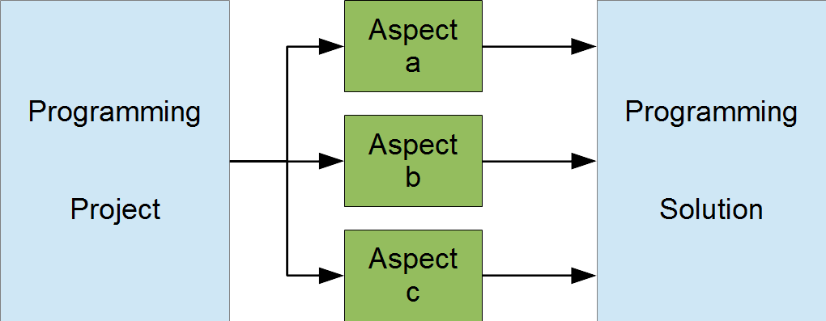
Modules Design Principles
We can sub-divide a programming project in different ways.
Select our modules so that each one focuses on a narrower aspect of the project.
Our objective is to define a set of modules that simplifies the complexity of the original problem.

Slide 14
Modules Design Principles (cont.)
Some general guidelines for defining a module include:
The module is easy to upgrade
The module contains a readable amount of code
The module may be used as part of the solution to some other problem
For a structured design, we stipulate that:
Each module has one entry point and one exit point
Each module is highly cohesive
Each module exhibits low coupling

Slide 15
Module Identifying
#include <stdio.h>
int n ;
Lowly cohesive
An input operation in a processing module is not encouraged.
➔ All the code in a module focus to the purpose of the module
High coupling
Some modules access a common data is not encouraged.
➔ All modules should be self-contained (independent)
Module for summing divisors of n
{ accept n
sum of it’s divisors
}
Module for printing out divisors of n
{ accept n
print out it’s divisors
}
int main ()
{
access n
}

Slide 16
Module identifying - Cohesion
Cohesion is a measure of the focus within a module.
A module performs a single task highly cohesive.
A module performs a collection of unrelated tasks low cohesion.
In designing a cohesive module, we ask whether a certain task belongs:
The reason to include it is that it is related to the other tasks in some particular manner.
A reason to exclude it is that it is unrelated to the other tasks.
How to identify modules? If you still use a verb to describe a task then a module is identified.

Slide 17
Module identifying - Degrees of cohesion
Low cohesion generally unacceptable
Coincidental - unrelated tasks
This module is not enough small Separate smaller tasks in this task.
Logical - This module contains some related tasks of which only one is performed
Separate them into separate smaller module, each smaller module for a choice.
Temporal - multiple logically unrelated tasks that are only temporally related
Separate them into separate smaller module although they are temporal
One module for two tasks:
- Sum divisors of the integer n
- Print out divisors of the integer n
In the case of the operation for summing of n is not used, this module can not be applied.

Slide 18
Module identifying - Degrees of cohesion
High cohesion - generally acceptable
Communicational - the tasks share the same data
All tasks are carried out each time.
Sequential - multiple tasks in a sequentially dependent relationship.
Output of one task serves as input to another task - the module identifier suggests an assembly line.
Functional - performs a single specific task
The module identifier suggests a precise verb phrase
Some modules share the common data can be accepted if they perform their tasks sequentially.

Slide 19
Module identifying - High Coupling
High Coupling - It's not advisable
Coupling is a measure of the degree of interrelatedness of a module to its referring module(s).
A module is low in coupling if it performs its tasks on its own.
A module is highly coupled if it shares that performance with some other module including the referring module It should not be used.
In designing for low coupling, we ask what kind of data to avoid passing to the module.

Slide 20
Module identifying - Coupling classification
The data classifications include:
Data - used by the module but not to control its execution Data in/dependant
Control - controls the execution of the module Control in/dependent
External - part of an environment external to the module that controls its execution
Common - part of a global set of data
Content - accesses the internals of another module
high
low

Slide 21
Example - High Cohesion & Low Coupling
Problem: Develop a program that will accept a positive integer then sum of it’s divisors is printed out.
Modules design:
Main Program
Module 1
Input Handling
Module 2
Summing Divisors
Module 3
Printing Divisors

Slide 22
Example - High Cohesion & Low Coupling (cont.)
Module 1: Input Handling
This module is responsible for reading the value of n from the user.
Module 2: Summing Divisors
This module calculates the sum of all divisors of a given integer.
Module 3: Printing Divisors
This module prints all divisors of a given integer.
Main Program
This module coordinates the other modules. It uses input, calculates the sum of divisors, and prints the divisors.

Slide 23
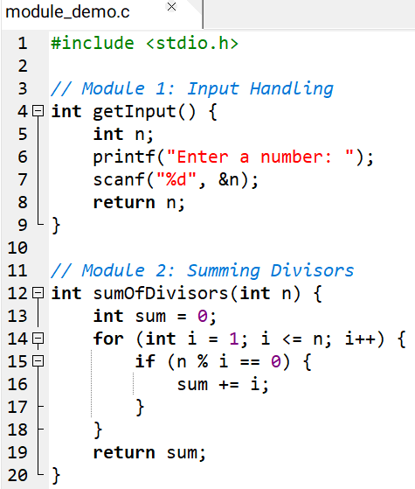
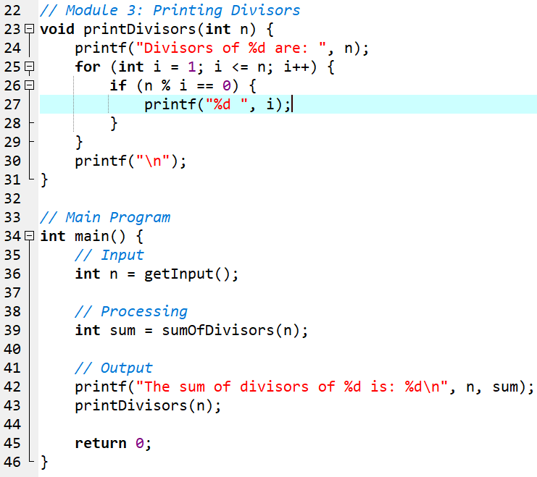
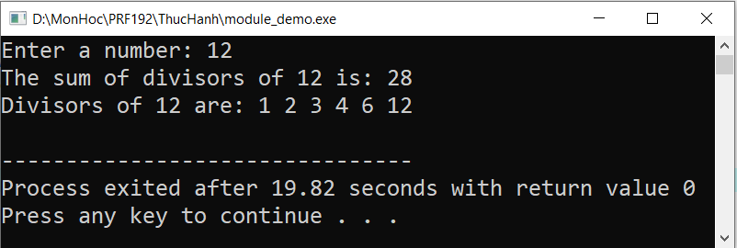
Example - High Cohesion & Low Coupling (cont.)
Output

Slide 24
Example Explain - High Cohesion & Low Coupling
High Cohesion: Each module has a single, well-defined purpose
getInput: Handles user input.
sumOfDivisors: Calculates the sum of divisors.
printDivisors: Displays all divisors.
Low Coupling:
Each module operates independently and communicates only via function calls and return values.
No global variables are shared between modules.
Reusability: Each module can be reused in other programs without modification
Ease of Maintenance: Modifications to one module (e.g., changing the input method) won't affect others.

Slide 25
Module identifying : How to create them?
If you still use a verb to describe a task then a module is identified.
In practice:
List all of the tasks (verbs) that the program should perform to solve this problem.
Identify the modules (verbs) for the problem structure
Check that each module is high in cohesion (each basic task is a module)
Check that each module is low in coupling (modules are independent)

Slide 26
4 - C-Functions and Modules

Slide 27
C-Functions and Modules
In C, we represent a module by a function.
A function is a block of reusable code designed to perform a specific task. A function may receive data and may return a value.
Example:
Print out divisors of the integer n n is data is accepted by the function and no value is returned.
n =12 Print out values: 1, 2, 3, 4, 6, 12
Sum of divisors of the integer n n is data is accepted by the function and a value is returned.
n =12 28 is the return value
The description of the internal logic of a function as the function's definition.

Slide 28
Function Definitions
Function Syntax:
Function header
What is the result of the task
returnType functionName ([ Type param1, Type param2, …])
{ <code> [return value; ] }
Function body
How does this task do?
What is the name of the task?
To do this task, what are necessary data?

Slide 29
Function Definitions - Example
return DataType
Function Identifier
Parameters
double average (int a, int b, int c)
{
double result;
result = (a+b+c)/3. ;
return result;
}
Body:
Logical construct
Review
3.0 and 3. are the same
3.3500 = 3.35
3.30 = 3.3
3.0 = 3.
Review:
(a+b+c)/3 → integer
Review:
(a+b+c)/3.0 → double

Slide 30
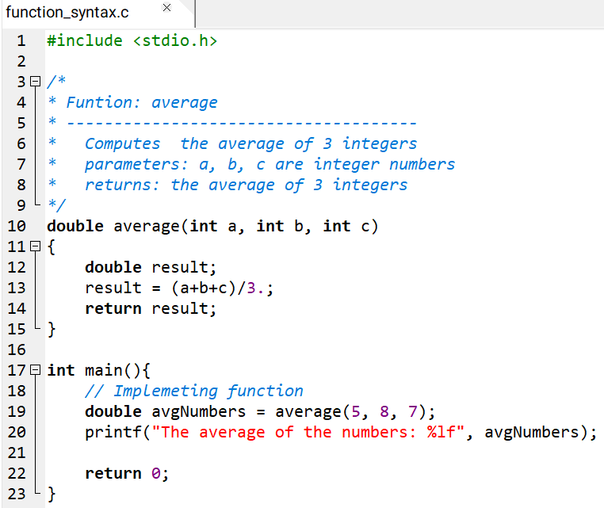
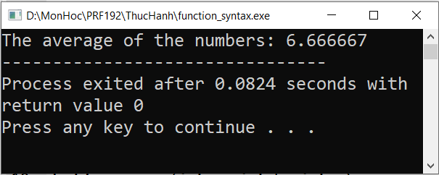
Function Definitions - Example (cont.)

Slide 31
Function syntax: void function
To identify a function that does not return any value, we specify void keyword for the return data type and exclude any expression from the return statement:
Alternatively, we can omit the return statement altogether.
A function that does not return a value is called a subroutine or procedure in other languages.
Syntax:
void functionName ([ Type param1, Type param2, …. ])
{
// Statements
}

Slide 32
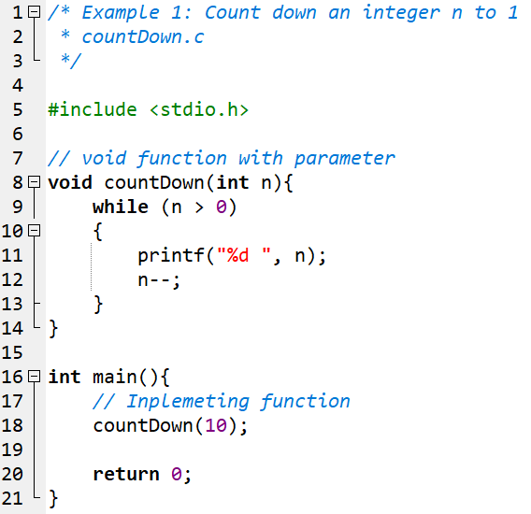
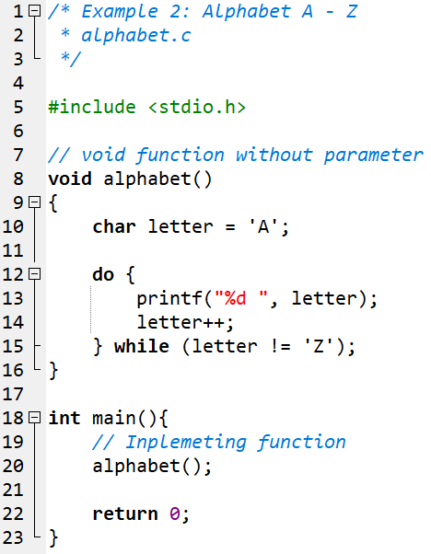
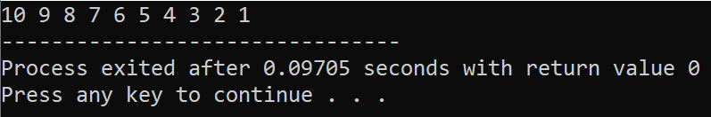
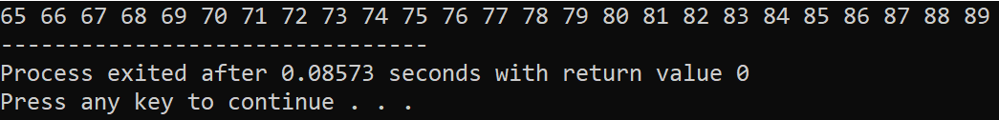
void function - Example

Slide 33
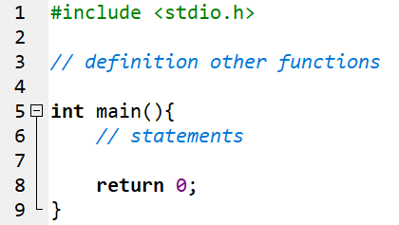
main function
The main() function is the function to which the operating system transfers control at the start of execution.
main() returns a value to the operating system upon completing execution. C compilers assume an int where we don't provide a return data type.
The operating system typically accepts a value of 0 as an indicator of success and may use this value to control subsequent execution of other programs.
main() is the entry point of a C- program

Slide 34
5 - How to implement a function?

Slide 35
How to implement a function?
State the task clearly: Verb + nouns (Objects)
Verbs:
Find,
Compute,
Count,
Check
functionName(Type param1, Type param2)
{
<steps of processing>
return [ Expression];
}
int | long | ...
void
Others
Give values to the parameters;
Carry out the work with yourself;
Write down steps;
Translate steps to C;
A task is described clearly if the receiver does not need to ask any thing

Slide 36
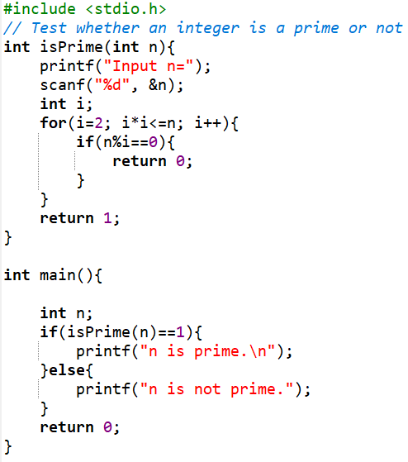
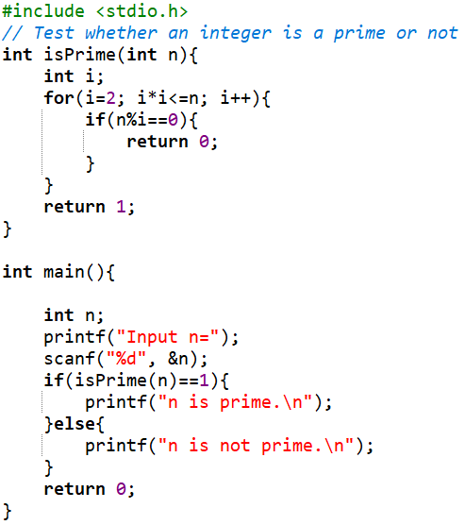
Evaluate the functions
This function contains a sub-task
→ low cohesive.
Better
Functions for testing will return 1 for true and 0 for false.
Common algorithm in testing is checking all cases which cause FALSE. TRUE is accept when no case cause FALSE
fix

Slide 37
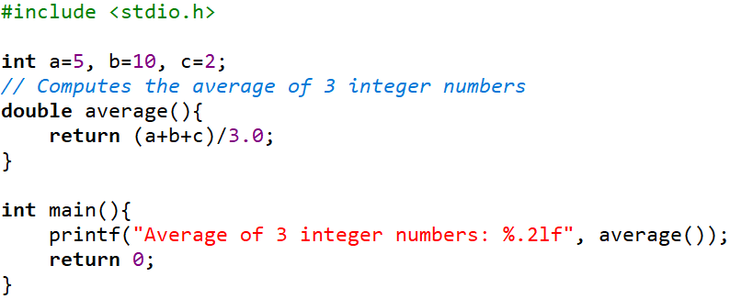
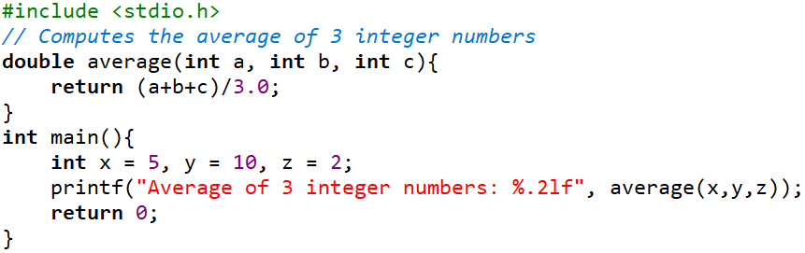
Evaluate the functions
This function accesses outside data
→ rather coupling
fix
Better

Slide 38
6 - How to use a function?

Slide 39
How to use a function?
In C, you can use either the built-in library functions or your own functions.
If you use the built-in library functions, your program needs to begin with the necessary include file.
Syntax for using a function:
Distinguish parameters and arguments
Parameters: names of data in function implementation
Arguments: data used when a function is called
functionIdentifier (argument1, argument2, …);

Slide 40
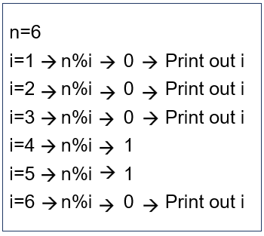
Practice 1
Develop a program that will perform the following task in three times:
Accept a positive integer.
Print out it's divisors
Analyze: Print out divisors of the positive integer n
solution
for i=1 … n
if (n%i ==0) print out i;
User-defined function
void printDivisors(int n)
{
int i;
for ( i=1; i<=n; i++)
if (n%i==0) printf(“%d, ”, i );
}

Slide 41
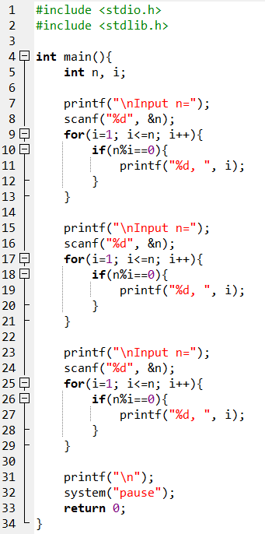
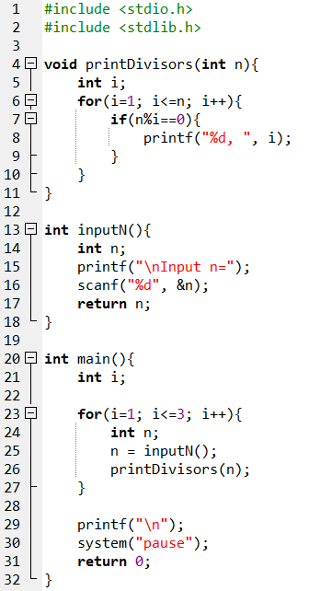
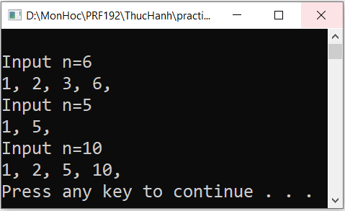
Practice 1 - Solution
A function can be re-used.
parameter
Same output
User-defined
function
repeat
Call function
argument
What do you think if the program will perform this task 20 times?

Slide 42
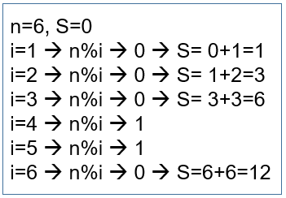
Exercise 1
Develop a program that will accept a positive integer then sum of it’s divisors is printed out.
Requirement: Implementation of User-defined function
Hint:
Sum of divisors of the positive integer n

Slide 43
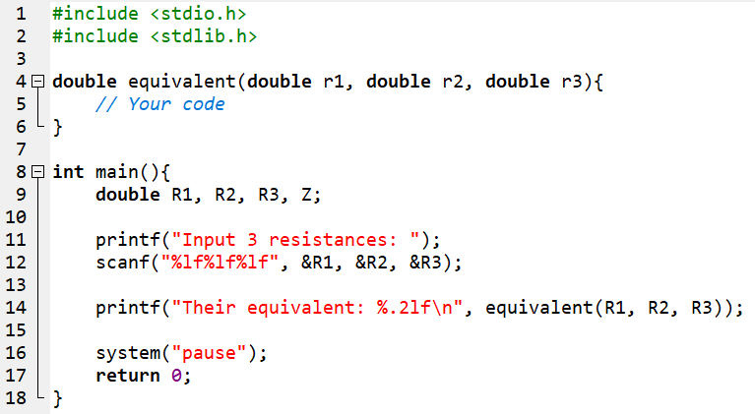
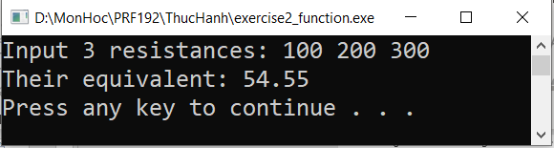
Exercise 2
Develop a program that will accept 3 parallel circuit resistances and their equivalent is printed out.
Complete the program below:
1/Z = 1/r1 + 1/r2 + 1/r3 → Z = ?

Slide 44
Function Prototypes
Function prototypes describe the form of a function without specifying the implementation details
Function prototypes declaration is put at a place and it’s implementation is put at other.
Syntax:
When the program is compiled:
Step 1: The compiler acknowledges this prototype (return type, name, order of data types in parameters) and marks places where this function is used and continues the compile process.
Step 2: If the function is detected, the compiler will update the marks in the previous step to create the program. Else, an error is thrown.
returnType functionIdentifier ([Type1 param1, Type2 param2, . . . ]);

Slide 45
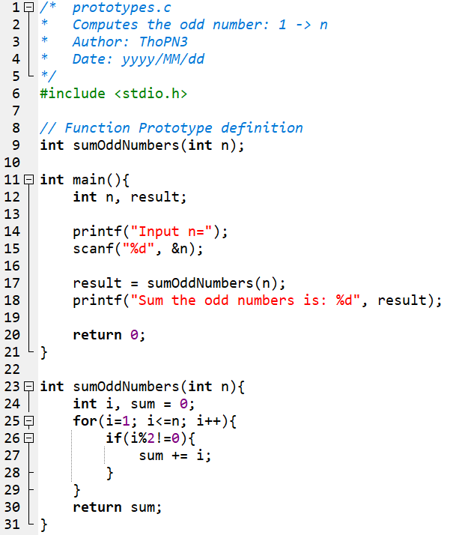
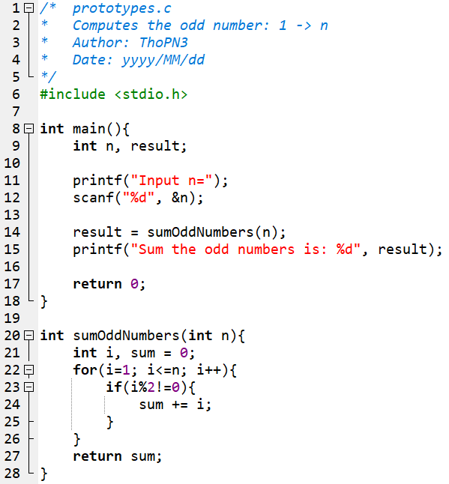

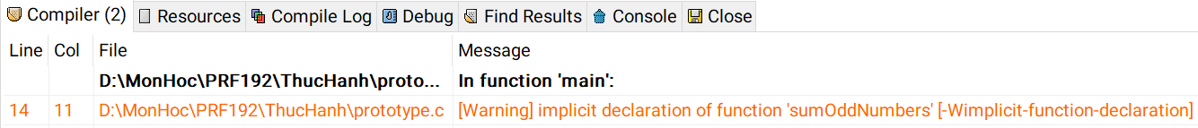
Function Prototypes - Example

Slide 46
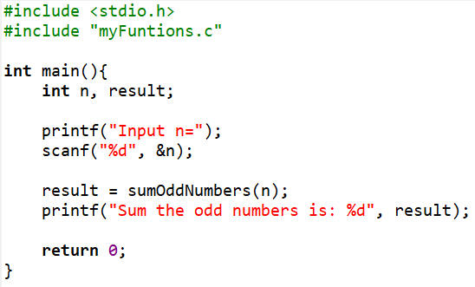
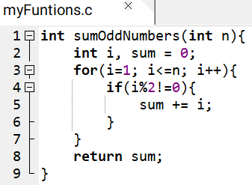
The #include directive
We use the #include directive to instruct the compiler to insert a copy of the header file into our source code.
Syntax:
Example:
#include "filename" // in user directory
#include <filename> // in system directory

Slide 47
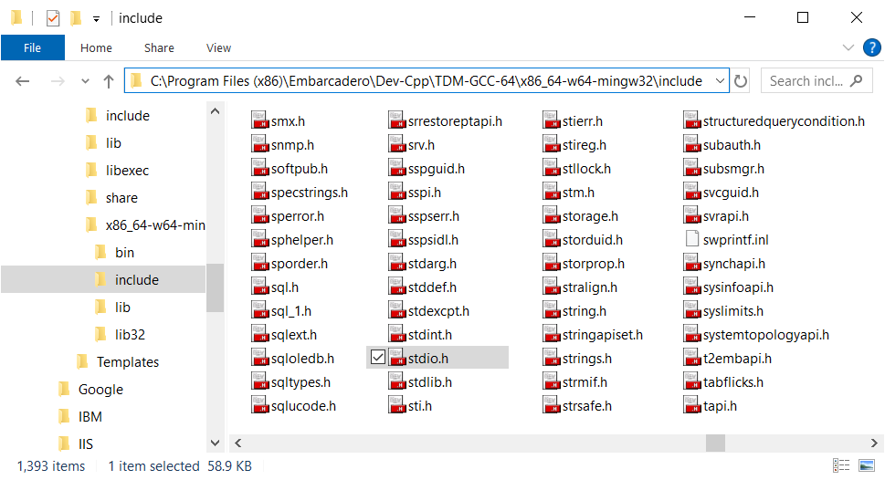
The #include directive (cont.)
System directory: The include directory of the select programming environment (such as Dev-Cpp)

Slide 48
Function Programming Style
For style, we
Declare a prototype for each function definition
Specify the return data type in each function definition
Specify void for a function with no parameters
Avoid calling the main function recursively
Include parameter identifiers in the prototype declarations
Use generic comments and variables names so that we can use the function in a variety of applications without modifying its code

Slide 49
7 - What happen when a function is called?

Slide 50
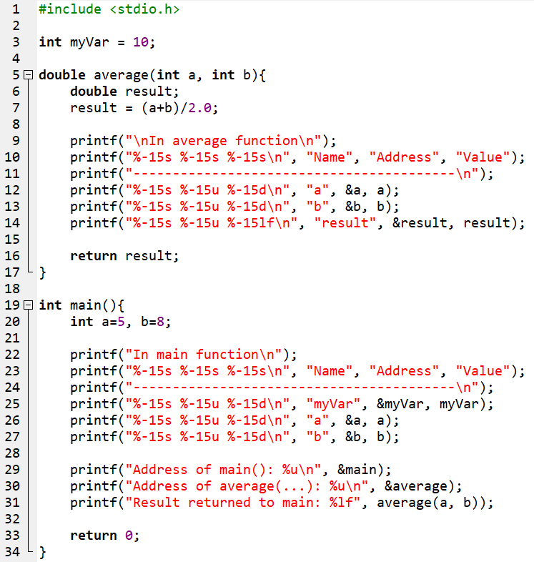
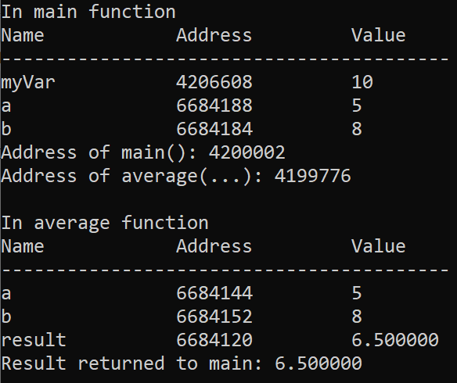
Memory map when a function is called
Data segment
42026608
myVar=10
Code segment
Code of main()
4200002
Code of average()
Memory mapping
4199776
HEAP
STACK
segment
6684188
a = 5
6684184
b = 8
6684152
6684144
66841120

Slide 51
Memory map when a function is called
Data segment
42026608
myVar=10
Code segment
Code of main()
4200002
Code of average()
4199776
HEAP
3
2
STACK
segment
6684188
a = 5
6684184
b = 8
copy
2
6684152
b = 8
1
6684144
a = 5
3
66841120
result = 6.500000

Slide 52
Pass by value
C-language uses the “pass by value” only when passing arguments to called functions.
The function receives copies of the data supplied by the arguments in the function call (The compiler allocates space for each parameter and initializes each parameter to the value of the corresponding argument in the function call).
So, anything passed into a function call is unchanged in the caller's scope when the function returns
Parameters and arguments stored in different addresses
Although they have the same names, they are still different
When a called function completes it’s task, it’s memory block, allocated, is de-allocated.

Slide 53
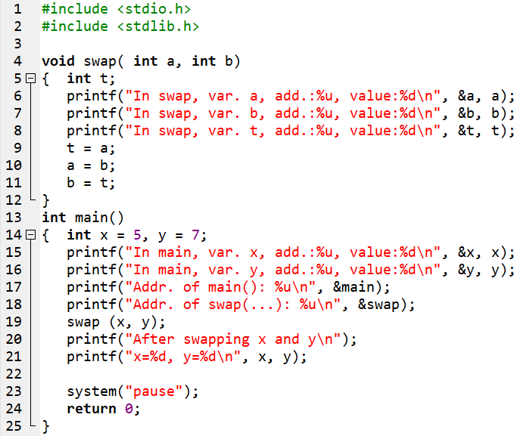
Exercise 3
A program for swapping two integers is implemented as this code.
Rewrite, compile and run this program.
Draw memory map
Explain the result

Slide 54
8 - Analyse a program to functions

Slide 55
Analyse a program to functions
// library functions
#include <stdio.h>
void verb1 ( Type a)
{ }
int verb2(Type b)
{ ...... return 3*b; }
int main()
{
int a, b, c;
verb1(a); // call function
printf(“%d\n”, verb2(b) );
<suitable statements>
}
Pick
nouns
Variables a, b, c
(Suitable types)
Problem
Begin
Verb1 a ; // complex
Verb 2 b; // complex
Verb 3 c; // Simple
...
End.
Re-order
requirements
to get
a logical
order
(Algorithm)
Simple task:
Input/Output simple variables
→ Use library functions

Slide 56
9 - Implement a program using functions

Slide 57
Implement a program using functions
Example: Develop a program that will print out the n first primes.
Analysis
Nouns: the integer n → int n
Verbs:
- Begin
- Accept n → simple
- Print n first primes → function
- End.
Analysis
Function printNPrimes (int n)
int count = 0;
int value = 2;
while (count <n)
{
if ( value is a prime → function
{
count = count +1;
print out value; → simple
}
value = value +1;
}
Result:
Input: n=5
Output: 2, 3, 5, 7, 11

Slide 58
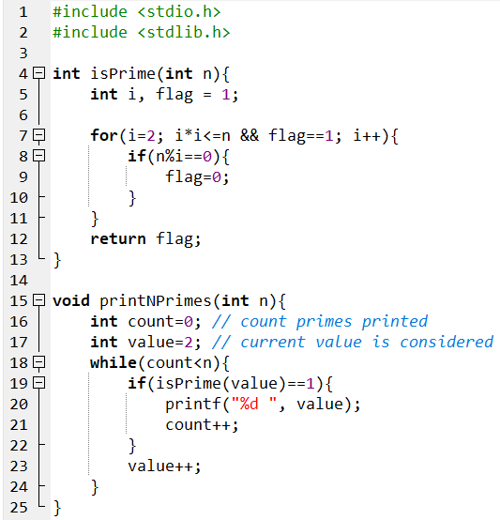
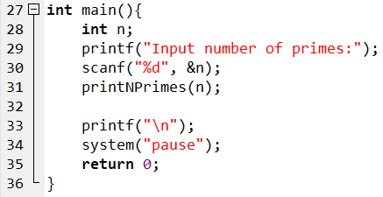
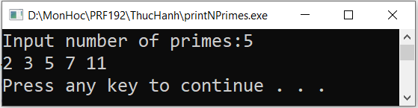
Implement a program using functions (cont.)
continue
Compile & Run

Slide 59
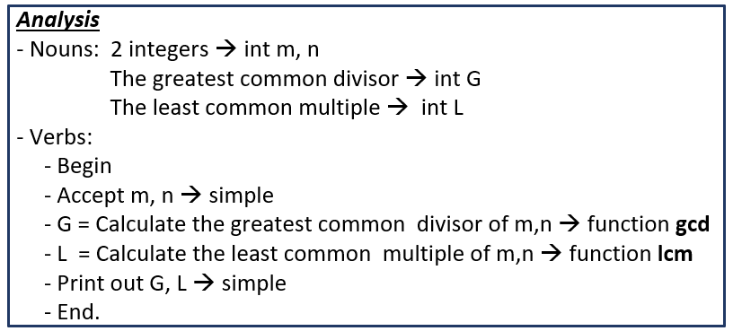
Exercise 4
Develop a program that will accept two positive integers then print out the greatest common divisor and the least common multiple of them.
Hint:

Slide 60
10 - Extent and Scope of a variable

Slide 61

Extent and Scope of a variable
Extent of a variable: Duration begins at the time the memory of this variable is allocated to the time this block is de-allocated.
Scope of a variable: The code block between the line which this variable is declared and the close brace of this block. In it’s scope, the variable is visible ( means that accessing to this variable is valid).
Global Variables: Variables declared outside of all functions They are stored in the data segment. If possible, do not use global variables because they can cause high coupling in functions.
Local Variables: Variables declared inside a function They are stored in the stack segment.

Slide 62
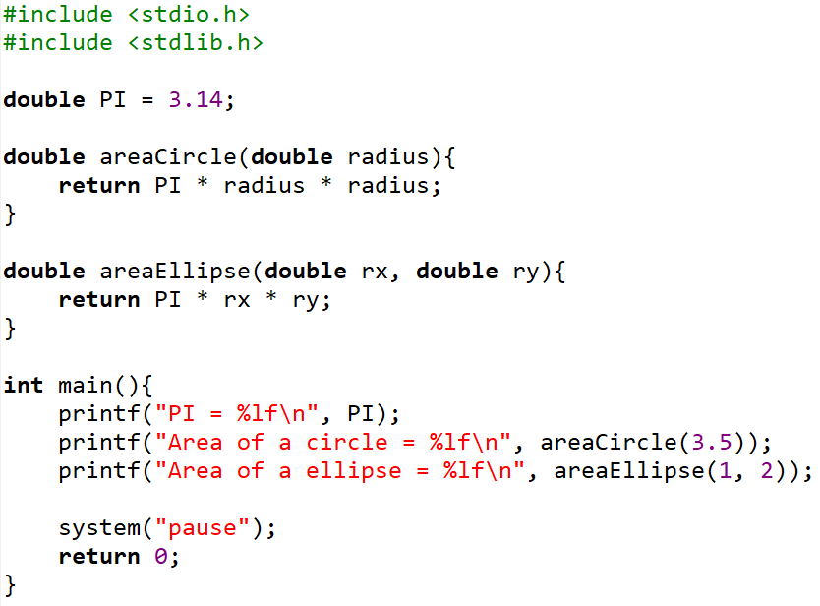
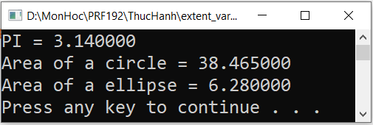
Extent of Variables: Time-View
Program Terminates
rx
ry
Time-View
r
Program
Starts

Slide 63
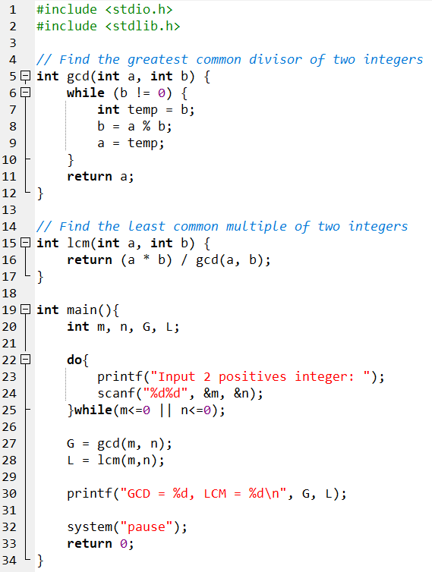
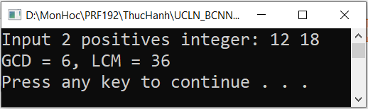
Scope of Variables: Code-View
Local variables of the function gcd include: memory containing return value (int), a, b
Local variables of the function lcm include: memory containing return value (int), a, b
Local variables of the function main include: memory containing return value (int), m, n, G, L

Slide 64
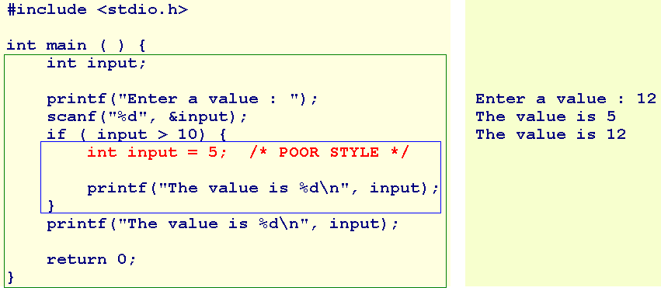
Extent and Scope of a variable: Visibility
Two variables have the same name (input) but they are different because the inner variable has the narrower scope than the outer variable → RULE: Local first, Global later

Slide 65
11 - Walkthroughs with Functions

Slide 66
Walkthroughs with Functions
Given the following function and a case of using it. What is the value of the variable t when the function terminates?
int f( int a, int b, int c)
{
int t= 2*(a+b-c)/5;
return t;
}
y=6 | x=5 | z=7 | f(a,b,c)
a | b | c | t
6 | 5 | 7 | 2*(6+5-7)/5 =1
t = 3*f(…) = 3*1 = 3
int x = 5, y= 6, z= 7;
int t = 3*f(y,x,z);

Slide 67
Exercise 5
n | n binary | n&(n-1)
1 | 0000 0001 | 0000 0001 0000 0000 0000 0000
2 | 0000 0010 | 0000 0010 0000 0001 0000 0000
4 | 0000 0100 | 0000 0100 0000 0011 0000 0000
8 | 0000 1000 | 0000 1000 0000 0111 0000 0000
16 | 0001 0000 | 0001 0000 0000 1111 0000 0000
Write a C program that will accept a non-negative integer then print out whether this number is power of 2 or not.
Hint:
Analysis
Variable: long n;
Operation: Check a long integer n whether it is power of 2 or not ( named isPower2 )
return ((n & (n-1))==0);
main function:
Do
accept n;
While (n<=0)
if (isPower2(n)==1) Print out “ It is power of 2”
else print out “ It is not power of 2”

Slide 68
Exercise 6
Write a C program that will
Accept 3 integers m, d, y that represent a date.
Print out they are valid or not.
Attention:
The February in a leap year will have 29 days.
If Y is a leap year then (Y%4==0 && Y%400 !=0) || (Y%100==0)

Slide 69
Summary
Module: A portion of a program that carries out a specific function and may be used alone or combined with other modules to create a program.
Advantages of modules: It is easy to upgrade and it can be re-used
C-function is a module
A function is highly cohesive if all it’s statements focus to the same purpose
Parameters make a function low coupling
4 parts of a function: Return type, function name, parameters, body
Syntax for a function:
returnType functionName( Type param1, Type param2, …)
{
<<statements>
}

Slide 70
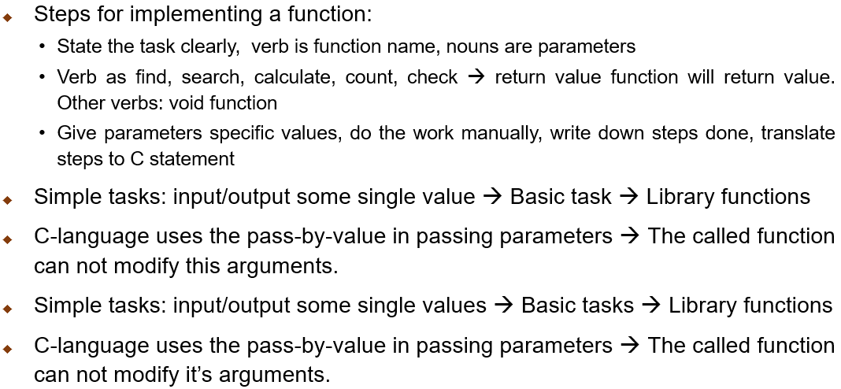
Summary (cont.)

Slide 71
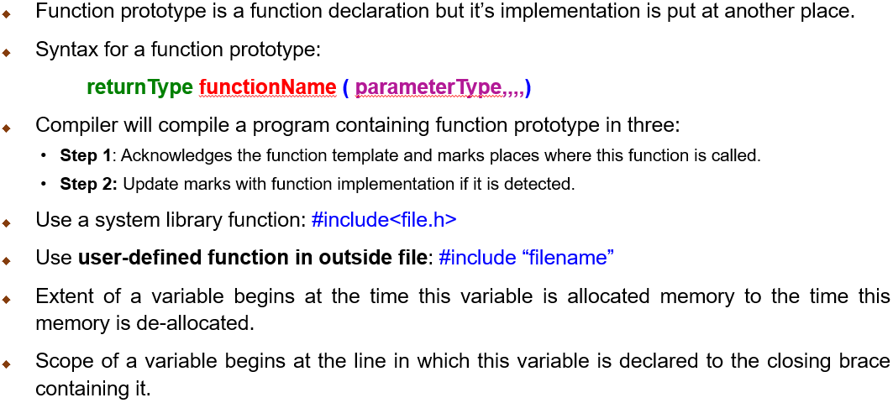
Summary (cont.)

